Slide 1



Session 2:
Image Processing
<number>
Notes:
<number>

Slide 2
Outline
Geometric Transformation
Translation
Rotation
Intensity Transformation
Histogram
Brightness Enhancement
Contrast Enhancement
Filter
Notes:
<number>

Slide 3
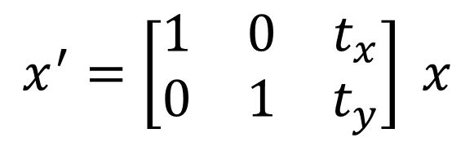
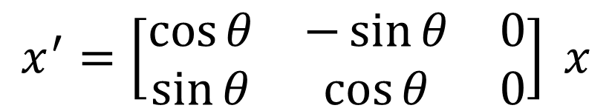
Geometric Transformation

Slide 4
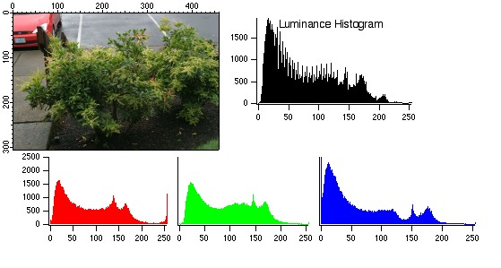
Intensity Transformation
Histogram

Slide 5
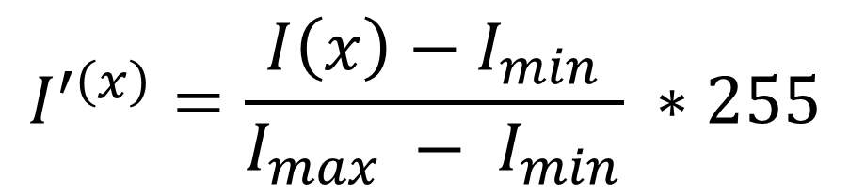
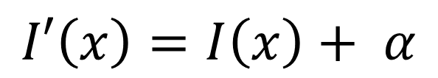
Color Transformation
Brightness Enhancement
Contrast Enhancement

Slide 6
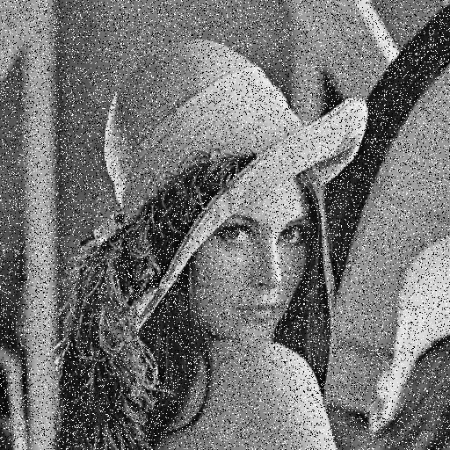
Filter
Salt and Pepper

Slide 7
Thank you!

